Slide 1

MOTIVATORS introduction:
Understanding WHAT MOVES US

Slide 2
Motivators Overview
Filter and guide decisions specifically toward results that reflect them
Combine uniquely for each person to influence individual priorities and decision-making
Help people to better understand their unique value or belief system
Notes:
Motivators help people to better understand their unique value hierarchy or belief system pertaining to what motivates them, what they are most drawn to and where their passions lie.
There are many benefits of learning what Motivators influence us.
The Motivators filter and guide decisions specifically toward results that will reflect them; they combine uniquely for each person to influence individual priorities and decision-making. It is vital for optimal performance that our motivations are satisfied by what we do. They drive our passions, reduce fatigue, and inspire us.

Slide 3
The Seven Dimensions of Motivation
Aesthetic – A drive for balance, harmony, and form.
Economic – A drive for return on investment.
Individualistic – A drive to stand out as independent and unique.
Power – A drive to be in control or have influence.
Altruistic – A drive to help others at the expense of self.
Regulatory – A drive to establish order, routine and structure.
Theoretical – A drive for knowledge learning, and understanding.
Notes:
While it’s important to explore each motivator and what they mean, it is critical to remember that they cannot be separated. They can only be distinguished. Through an understanding of the motivators, we can begin to see how to maximize performance by achieving stronger alignment between our motivators, our choices, and our actions
The 7 Motivators:
Aesthetic - a drive for balance, harmony, and form
Economic - a drive for a return on investment
Individualistic - a drive to stand out as independent and unique
Power - a drive to be in control or have influence
Altruistic - a drive to help others at the expense of self
Regulatory - a drive to establish order, routine, and structure
Theoretical - a drive for knowledge, learning, and understanding

Slide 4
Importance & impact
IMPORTANCE
IF I value it and HOW I value it
determined by high or low scores
IMPACT
How it influences my decisions & actions
determined by distance from norm – the ranking
Notes:
Both of these concepts are incredibly important in Motivators. While connected, there are different concepts to consider when reviewing the Motivators.
IMPORTANCE is determined by the score and comes in two parts – it explains IF I value the dimension and HOW I value it.
Let’s look at IF I value it first –
A High Score means that the expression of this Motivator is very important to me.
Example: If I am High Economic – getting a return on my investment is VERY Important.
A LOW Score means that this Motivators is not important to me.
Example: If I am Low Economic, a return on my investment is NOT important to me.
Now, how I value it. My score (whether high or low) reveals a descriptor of HOW I value the dimension. (We’ll see these later on the word sketch). When we are looking at HOW I value it:
A High ECO score shows Competitive. This is HOW I interact with this Motivator or the “thing” that drives me.
A Low ECO score shows Satisfied. This is HOW I interact with this Motivator or the “thing” that drives me.
If I am driven by competition, then everything becomes an opportunity for me to fight for the win. If I am satisfied, I won’t fight for the win, but rather take what is presented to me as it comes and make the best of it.
IMPACT is how it influences my decisions and actions and is determined by distance from norm shown as a ranking. When exploring impact there are few things to know as well:
Impact is determined by how far your score is away from NORMAL. Scores that fall within the Average will have less impact because the needs are without passion, where scores that are higher or lower have more passion for or away from. Those in the middle could go either way, depending on the situation.
If Impact tells us how that Motivators will affect our decisions and actions, it’s helpful to remember some people are driven to be LIKE others, and some are driven to be DIFFERENT.
If 7 out of 10 people are all doing things the same way, the only person who will be noticed (and also feel out of place) will be the outlier, doing things in a way others haven’t.
Because all people are looking to balance an individual existence with a shared/community existence, being like the population can have a great deal of impact on how we choose to behave. If we don’t want to stand out, we may choose what would make us seem alike, rather than stand out.
We’ll talk more about these concepts again when we look at report scoring, but remember these are crucial to understanding how and why our Motivators drive us.

Slide 5

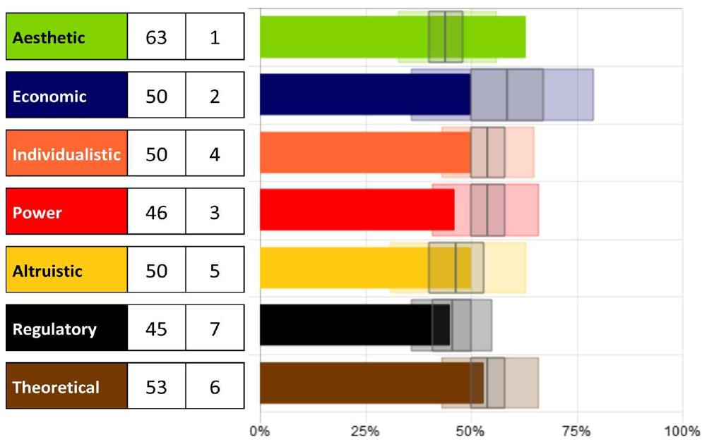
Scoring Motivators
The solid bar & number
The shaded area
The box plot
The norm line
Ranking
Notes:
Review Slide – show each of the 5 steps.

Slide 6
Scoring Summary
Whether scores are high or low, the motivators with the furthest distance above or below center (50%) will have the highest influence leading to the greatest impact on the decisions being made.
Both low and high scores can have an influence on the choices we make. Average scores (in the mid-range noted by a small box plot) create a normal degree of influence which is typically not noticeable.
The very high and very low can be “risk zones” – wants become needs.
Importance and Impact are both important measurements in Motivators.
Notes:
There are five score options for Motivators:
Very Low, Low, Average, High, Very High
Both low and high scores can have an influence on the choices we make. Average scores (in the mid-range noted by a grey box plot in the report) create a normal degree of influence which is typically not noticeable.
The very high and very low are "red zones" or danger zones.
Whether scores are high or low, the motivators with the furthest distance above or below the mean (or norm - the grey line in the center of the box plot) will be the highest influencers leading to the greatest impact on the decisions being made. The impact will be specific to the score (high means different than low) but the influence will be as powerful whether the score is above the line or below.

Slide 7
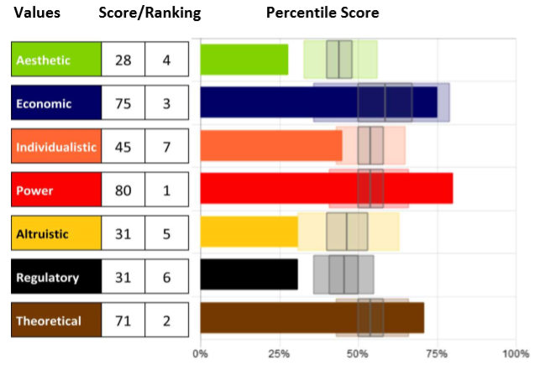
Motivational Summary
Insights for each motivator - an overview graph and user specific statement sets for further development.

Slide 8
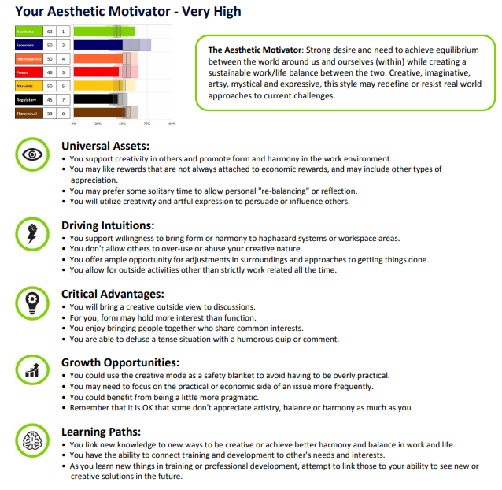
Individual Motivators Pages

Slide 9
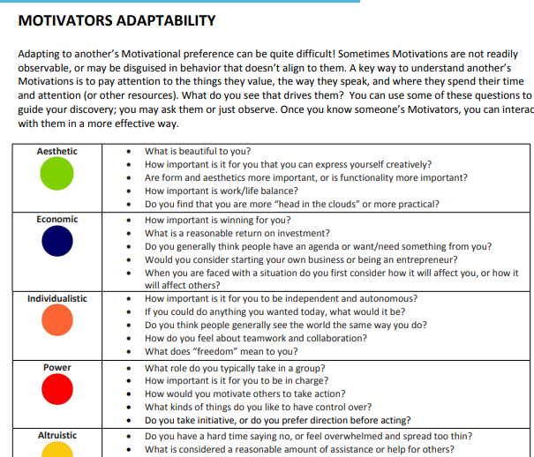
Adaptability

Slide 10
Tiny Steps, Big Results
Reflection and Action:
What works? What does not work?
Where do I excel and what Motivators are engaged?
What Motivators need attention?
What ineffective influence can I eliminate?
What effective influence can I act on?

Slide 11
Coaching Opportunities
Use open-ended and purposeful follow-up questions to uncover opportunities and reveal areas support is needed. Discuss:
What are the primary motivators for this person?
How do those show up? What behaviors link to those drivers?
What awareness do they have about their individual scores?
Are those scores accurate and reflective of their mindset?
How do those motivators and that mindset influence their choices and behaviors?
Are their behaviors reflecting their wants accurately? If not, why not and should something be done to align them more closely?

